Slide 1
Designing the Logic for a Number Guessing Game

Slide 2
Random numbers
random.random() * max
0.0 to 1.0
* 100
0.0 to 100.0
0.65 becomes 65
You can also use random.randint(min, max)

Slide 3
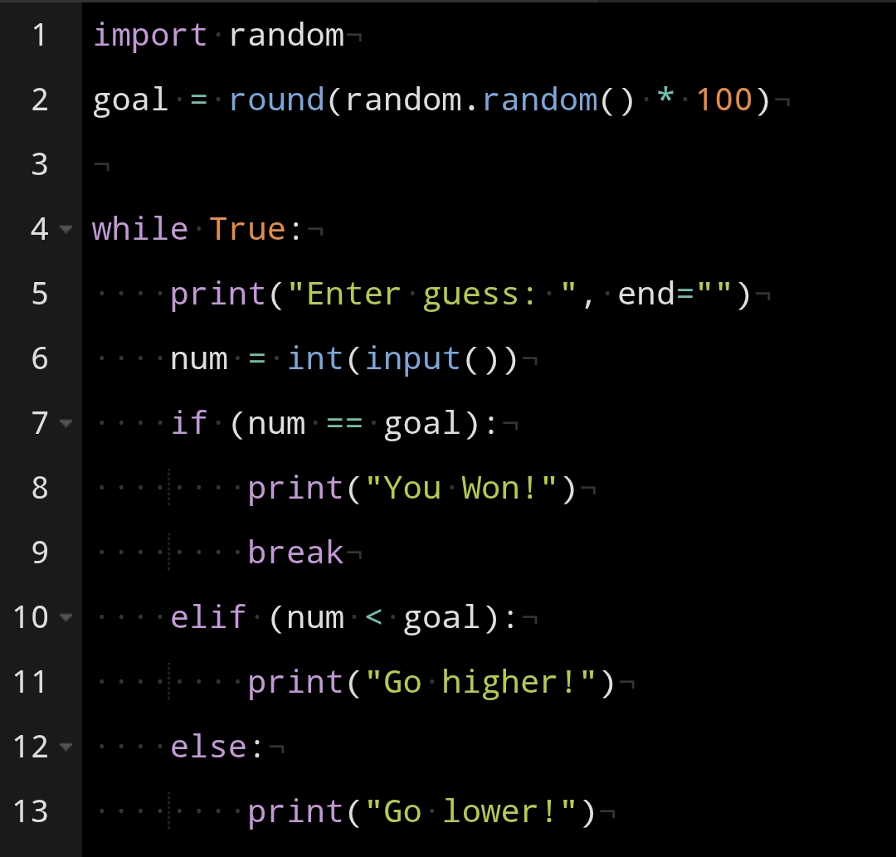
Code

Slide 4
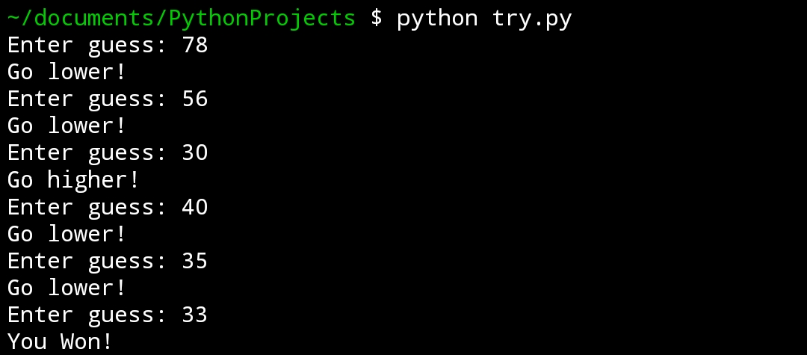
Gameplay

Slide 5
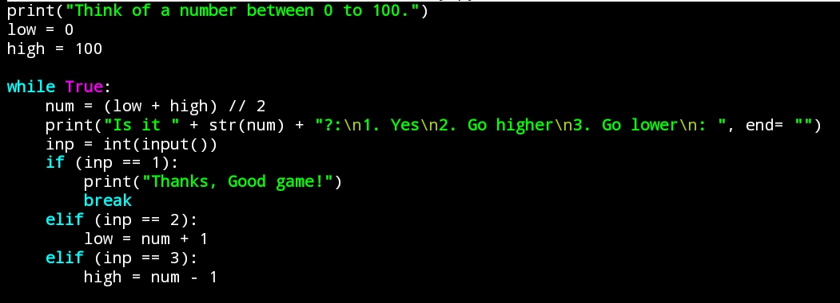
Bot Guesser: Binary Search

Slide 6
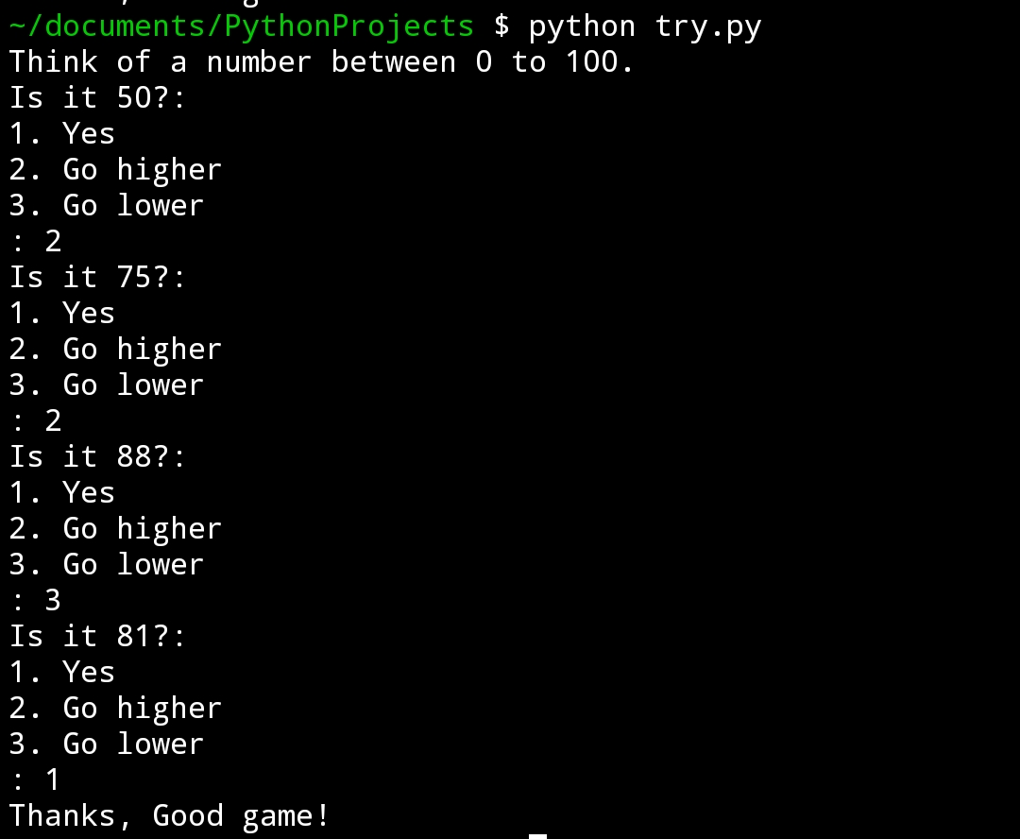
Gameplay

Slide 7
Let’s make it like a game:
Single display, no scrolling
Score system (ideas?)

Slide 8
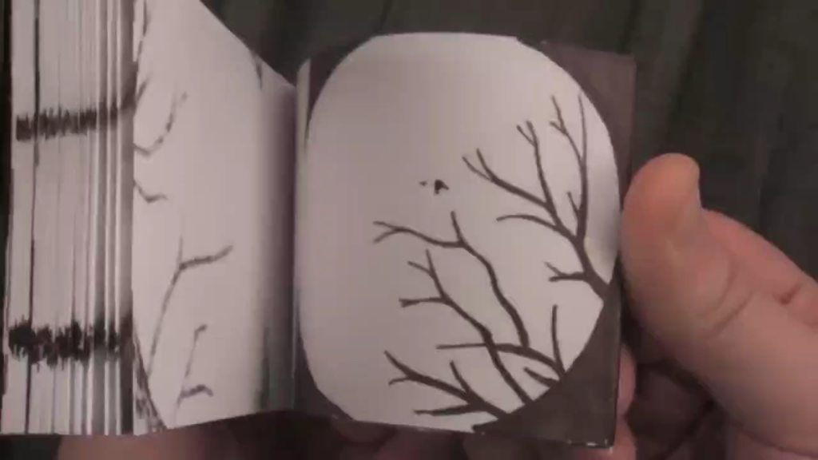
How are Animations made?

Slide 9
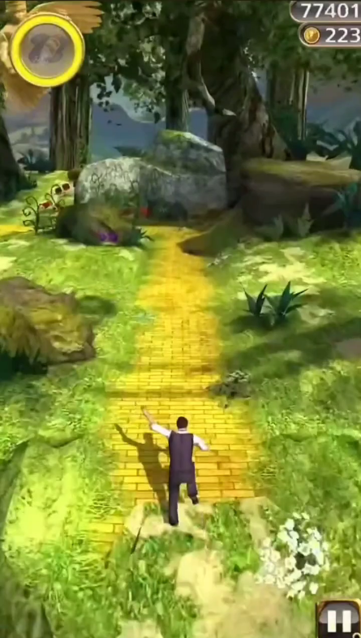
How to do scores?

Slide 10
Main Loop
Infinite loop
New Threads
Timers

Slide 11
How to take input while looping?
input() blocks the thread
curses: ncurses for Python
stdscr is our canvas
Input is a character stream

Slide 12
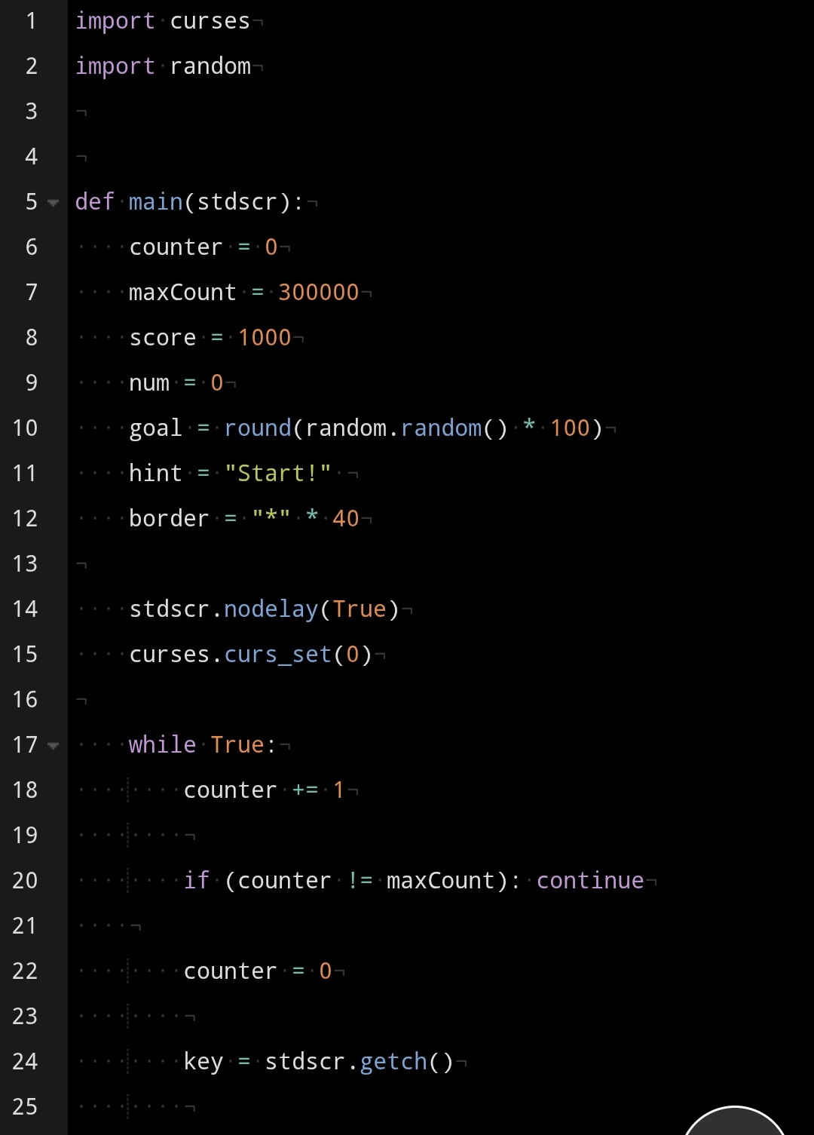
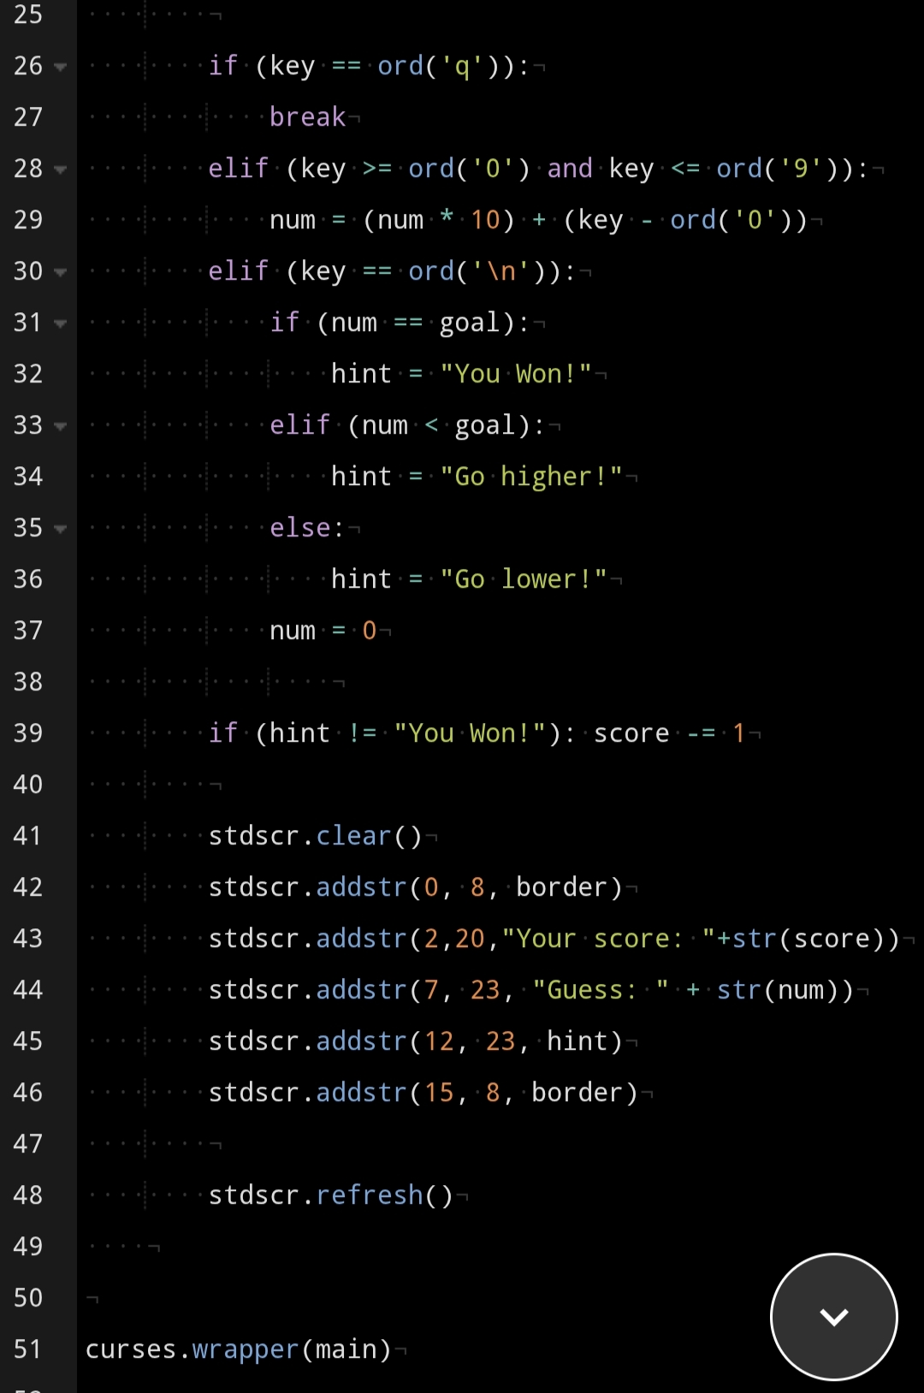

Slide 13
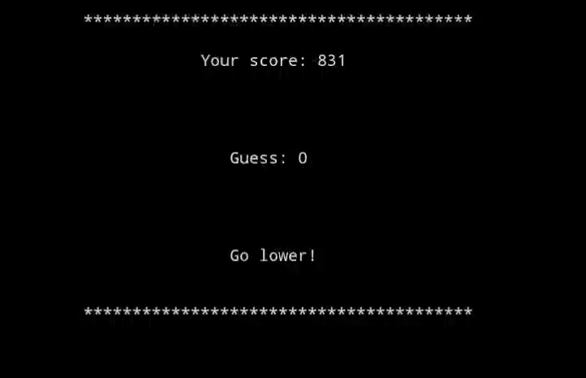

Slide 14
Thank You

